Slide 1
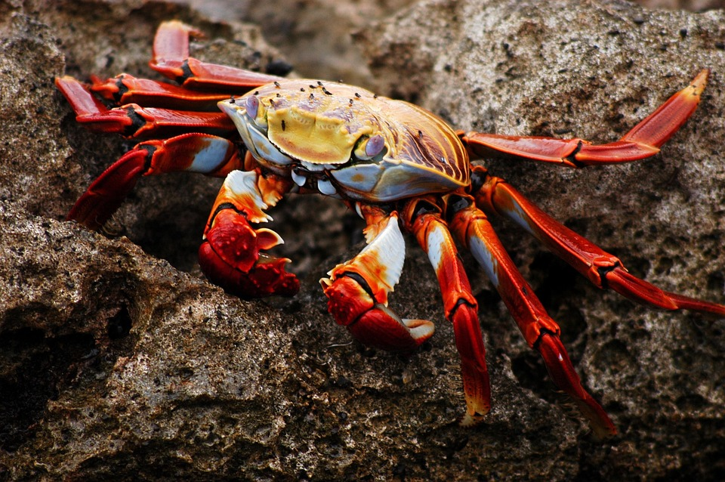
“Predicting Crab Age Using Regression Analysis” DDS DS 6306 final Project 2
Presented By:
Sue Camara
Date: April 21, 2025

Slide 2

Objectives
Objective A: Build a regression model to predict the age of crabs using physical features
Objective B: Analyze the dataset to identify key relationships that influence crab age

Slide 3
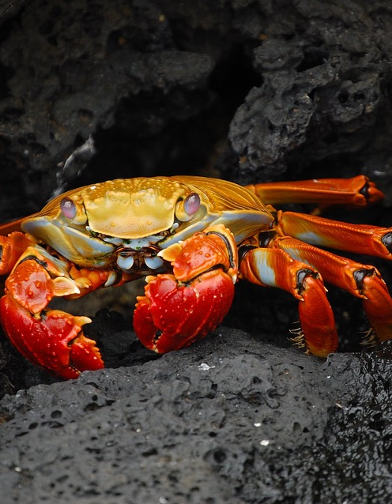
Why Predict Crab Age?
Helps scientists understand crab growth, reproductive cycles, and lifespan
Supports commercial fisheries and sustainability efforts
Can inform research on climate change and ocean pollution

Slide 4

Dataset Overview
We analyzed the relationships between crab physical measurements and age. The strongest correlations with age were observed in:
Shell Weight (0.69)
Height (0.66)
Diameter (0.63)
Length (0.62)
Weight (0.61)
Notes:
These variables are the most important predictors of crab age and will be prioritized in our predictive modeling. The heatmap visualizes these relationships, with darker shades indicating stronger positive correlations

Slide 5
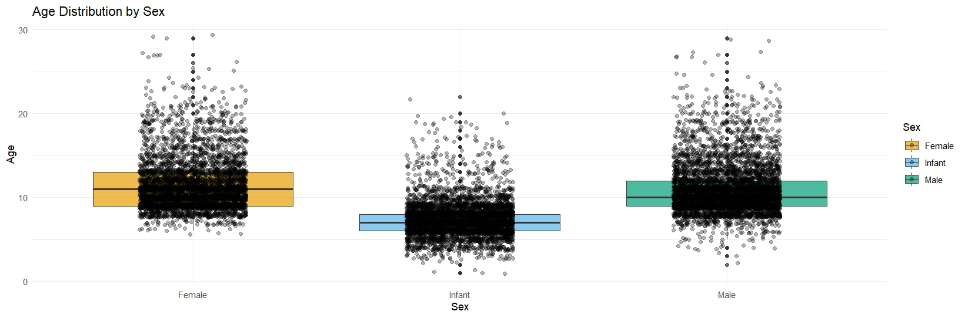
Exploratory Data Analysis
Age Distribution by Sex
Age distribution varies by Sex.
The age distributions for Female, Infant, and Male crabs show some variation, but all generally fall between ages 5 and 15, with some outliers above age 20.

Slide 6
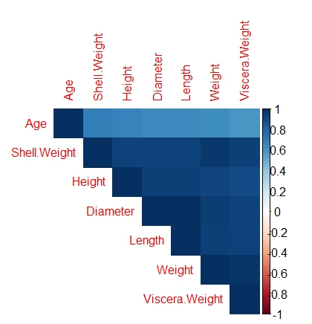
Exploratory Data Analysis
Correlation Matrix
Shell Weight has the strongest correlation with Age, making it a key predictor in the model.
Height, Diameter, and Length also show moderate positive correlations with Age, suggesting they are valuable features.
Viscera Weight has the weakest correlation with Age, indicating limited influence in age prediction
Notes:
Top predictors include Shell Weight, Height, Diameter.

Slide 7
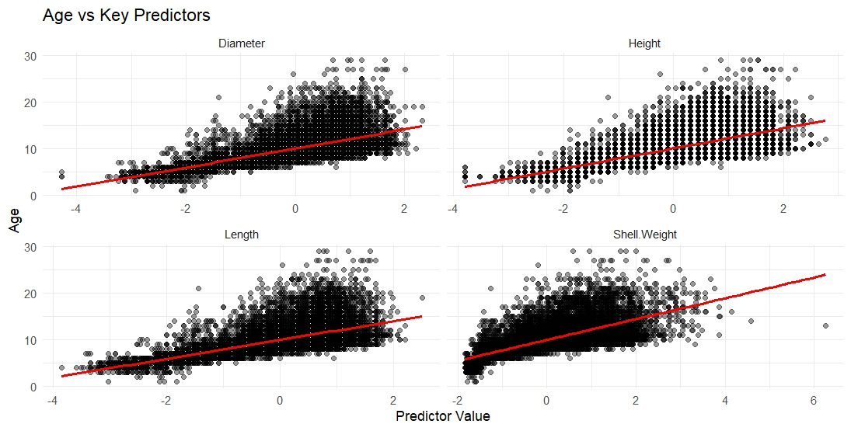
Exploratory Data Analysis
Age Vs Key Predictors
Positive linear trends are visible across all predictors, with Age increasing as physical measurements grow.
Shell Weight and Height show the strongest upward patterns, reinforcing their predictive strength from earlier analyses.
Notes:
The spread of points widens with larger values, especially for Length and Diameter, suggesting some non-linearity or variance that linear models might not fully capture.
Outliers are present but don't appear to distort the overall trends, indicating robustness in the relationships.

Slide 8
Model Training
Linear Regression
Random Forest
Decision Tree
Linear Regression performed reasonably.
Random Forest had the lowest MAE.
Decision Tree showed higher variance.
Cross-Validation: 5-fold
Metric: MAE (Mean Absolute Error)

Slide 9
Hyperparameter Tuning
Tuned Random Forest mtry parameter.
Optimal mtry = 3 with 500 trees.
Further reduced MAE after tuning.
Notes:
Model used for final prediction MAE on validation/test set Comparison to baseline model if needed

Slide 10
Validation Results Actual vs Predicted (Validation Set)
Shows model alignment with ground truth.
Most predictions fall near the 45° line.
Notes:
Model used for final prediction MAE on validation/test set Comparison to baseline model if needed

Slide 11
Rshinny Dashboard Brief Overview of features
Notes:
RShiny Dashboard Brief overview of features:User inputs crab characteristics Dashboard returns predicted ageVisuals: screenshots or summary description

Slide 12
Conclusion & key takeaways
​
"Predicting crab age using physical characteristics offers reliable results while contributing important insights into their biology and environmental interactions. This study highlights opportunities for refining prediction models and guiding future research in marine science.“
Key Takeaways
Random Forest achieved MAE ~1.40.
Shell Weight, Length, Diameter were most important features.
Data cleaning and proper feature engineering were crucial.

Slide 13
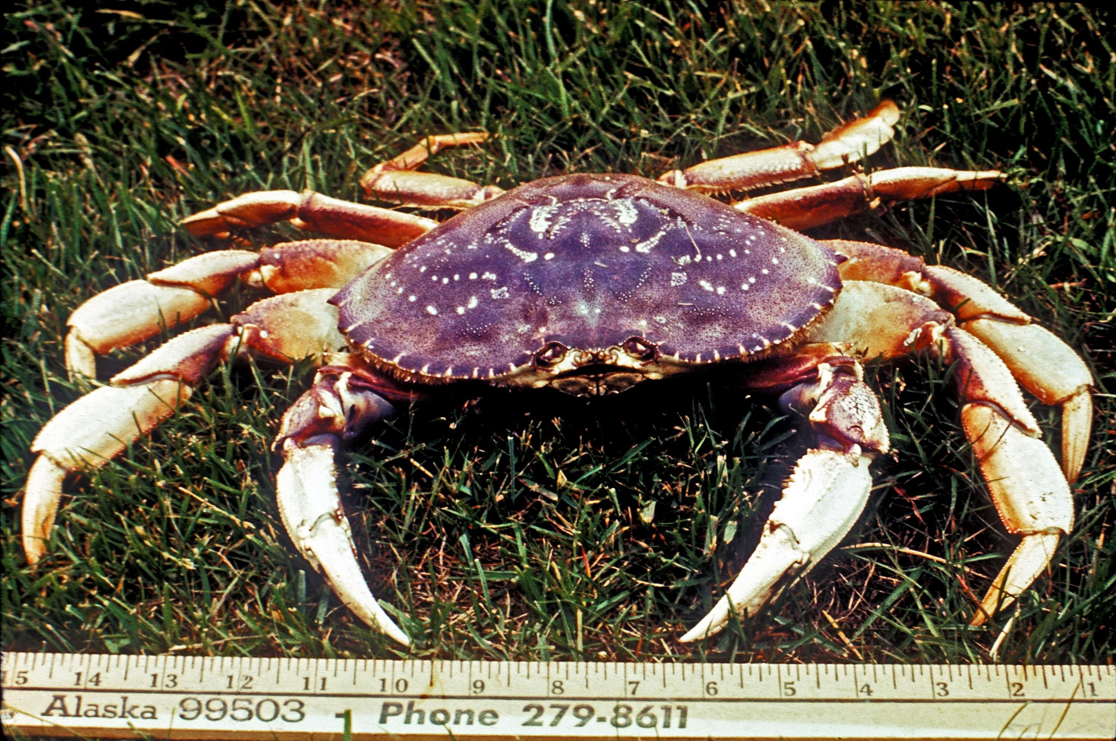
Thank you!
Sue Camara
scamara@smu.edu

